Slide 1
GRI South SG Meeting
15 November 2013

Slide 2
After only 1 year the early CAM implementation by PRISMA started successfully on 1 April 2013…
Platform go-live step by step. From idea to launch in less than a year.
20 Feb 2013
1 Apr 2013
15 Apr 2013
6 May 2013
Registration start
First DA auctions
First monthly auctions
First yearly auctions
Registration start for shippers in order to prepare April 1st
Application of the uniform-price auction algorithm
Application of the ascending-clock auction algorithm
Application of the ascending-clock auction algorithm

Slide 3
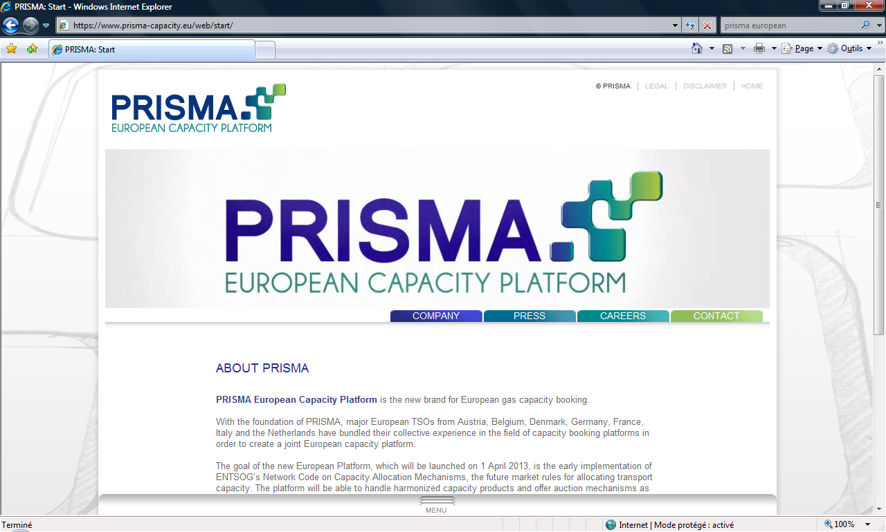
PRISMA has implemented almost all of the NC CAM requirements. Two years ahead of time.
www.prisma-capacity.eu
Capacity products
  Bundled products between hubs
  Unbundled products
  Products as defined in the CAM Network code
  Firm & Interruptible
All products available on one platform:
PRISMA European Capacity Platform
Allocation – Auction mechanisms as described in
the NC CAM
    Uniform price auction: day-ahead products
    Ascending clock algorithm: monthly, quarterly and yearly products
  The platform can also handle regional specificities, ensuring that European TSOs comply with their national regulation until NC CAM comes into force.

Slide 4

Beyond the future European requirements, PRISMA also provides additional services to TSOs and Shippers…
Centralised shipper and user registration on the platform
First-come-first-served booking at domestic points
Surrender of capacity
Conversion of interruptible into firm capacity
Multiple kinds of firm capacity, multiple interruptible levels
Competing capacity
1:n bundling
Credit limit check
Booking assignment to balancing groups and portfolios
Automated interface to deal capturing systems of shippers
Comfort functions for automated bidding
With a high number of state-of-the-art functionalities, the PRISMA platform provides an advanced way to fulfil the EU requirements.

Slide 5


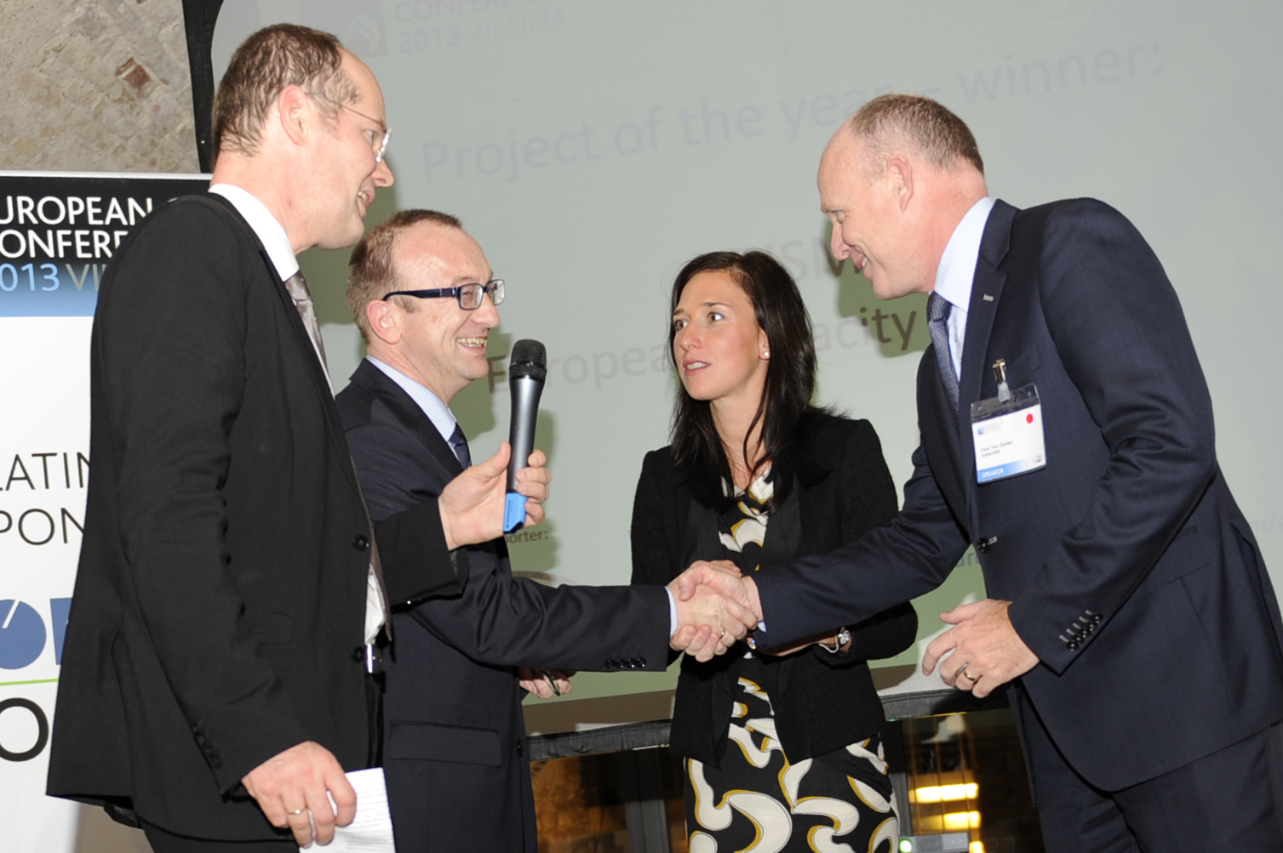
PRISMA has already reached significant acceptance and utilization in the market.
297 shippers with more than 900 users are using the platform to book transport capacity across European borders.
More than 28,000 auctions have taken place since the platform start
PRISMA held a public consultation on the platform functionalities and new GT&Cs. The public consultation ended on 16 September 2013 and an evaluation is currently being prepared.

Slide 6
Since PRISMA’s start, platform operations have been secure & stable with a large number of auctions taking place…
Capacity Auction Results:
  Yearly Capacity (243 auctions):
  Offered: 571.3 GWh/h
  Allocated: 172.2 GWh/h
  Quarterly Capacity (364 auctions):
  Offered: 932.4 GWh/h
  Allocated: 21.0 GWh/h
  Month-Ahead Capacity (587 auctions):
  Offered: 1,474.6 GWh/h
  Allocated: 37.9 GWh/h
  Day-Ahead Capacity (26,883 auctions):
  Offered: 53,563.1 GWh/h
  Allocated: 1,328.0 GWh/h

Slide 7
Number of Bundled Auctions that Ended with a Surcharge
Lasów
Zelzate
1
1
3
Oberkappel
Blaregnies/
Taisnières
1
4
53
Eynatten
Medelsheim/
Obergailbach
Since the start of the PRISMA platform in April 2013, 63 out of 5,454 bundled auctions ended with a surcharge.
X
Number of concluded auctions with a surcharge
X
entry
X
exit

Slide 8
Number of Unbundled Auctions that Ended with a Surcharge
Ellund
Emden
Oude
Statenzijl
Drohne
13
3
1
1
Oberkappel
1
3
1
Überackern
2
3
1
Wallbach
Medelsheim
Arnoldstein
Since the start of the PRISMA platform in April 2013, 29 out of 22,614 unbundled auctions ended with a surcharge.
X
Number of auctions with a surcharge (entry)
X
Number of auctions with a surcharge (exit)

Slide 9
Offered and allocated yearly capacities

Slide 10
Offered and allocated quarterly capacities
Nota: Cumulative Quaterly auctions (27/05/13, 29/05/2013, 04/06/2013)

Slide 11
Offered and allocated month ahead capacities

Slide 12
Offered and allocated day ahead capacities

Slide 13

In the following months PRISMA will provide further features to connected TSOs and Shippers…
Integrated secondary functionality on the platform
  Secondary functionality to be launched in January 2014
Multi-currency trading
  Launch of multi-currency currently foreseen for 2014
Within-Day
  Launch of within-day is foreseen
While ensuring stable operations of the PRISMA platform, PRISMA also continues the further platform development to fulfil both European and TSO individual requirements.

Slide 14
Current discussion with TSOs
Our view
  From Jan. 2014, National Grid (UK), Gaslink (Ireland) & TIGF (France) will become PRISMA shareholders
  We foresee that in 2014 and 2015 several further EU countries / TSOs will join PRISMA as shareholders
  Some TSOs may start auctioning capacity via pilot projects
Country / TSO(s) already part of PRISMA
Pilot Project
Country / TSO(s) currently discussing with
PRISMA to become involved in PRISMA as
shareholder and/ or using the platform for a pilot project

